Slide 1
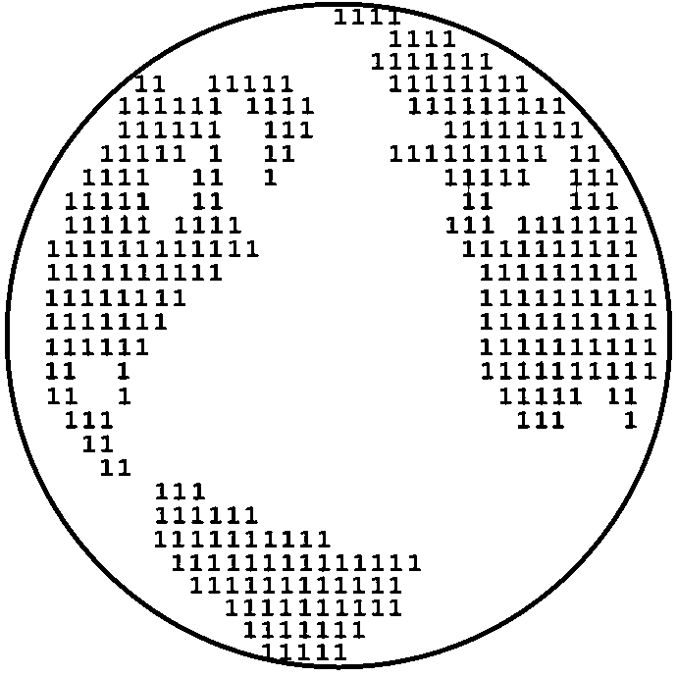
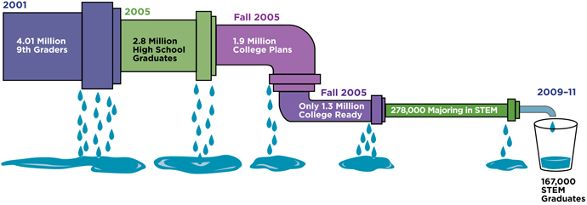
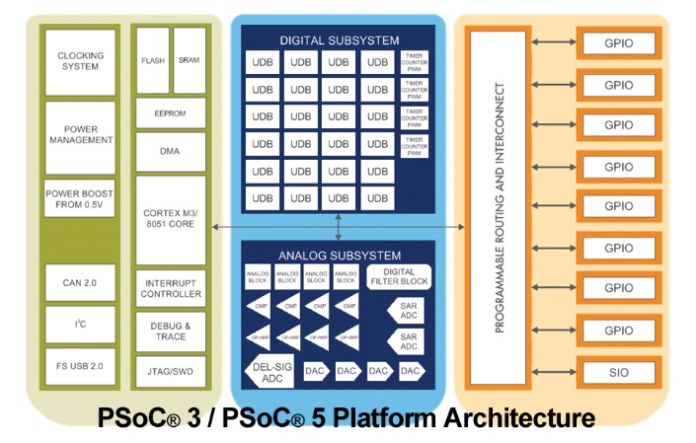

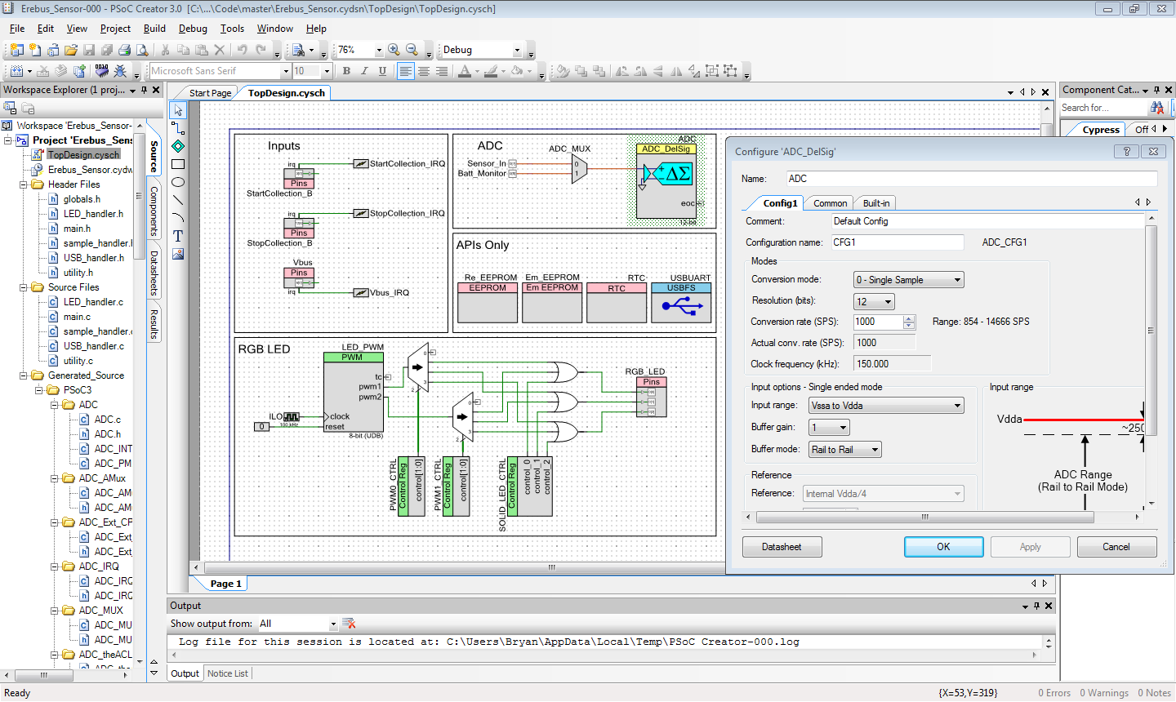
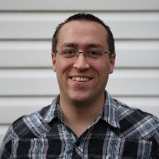

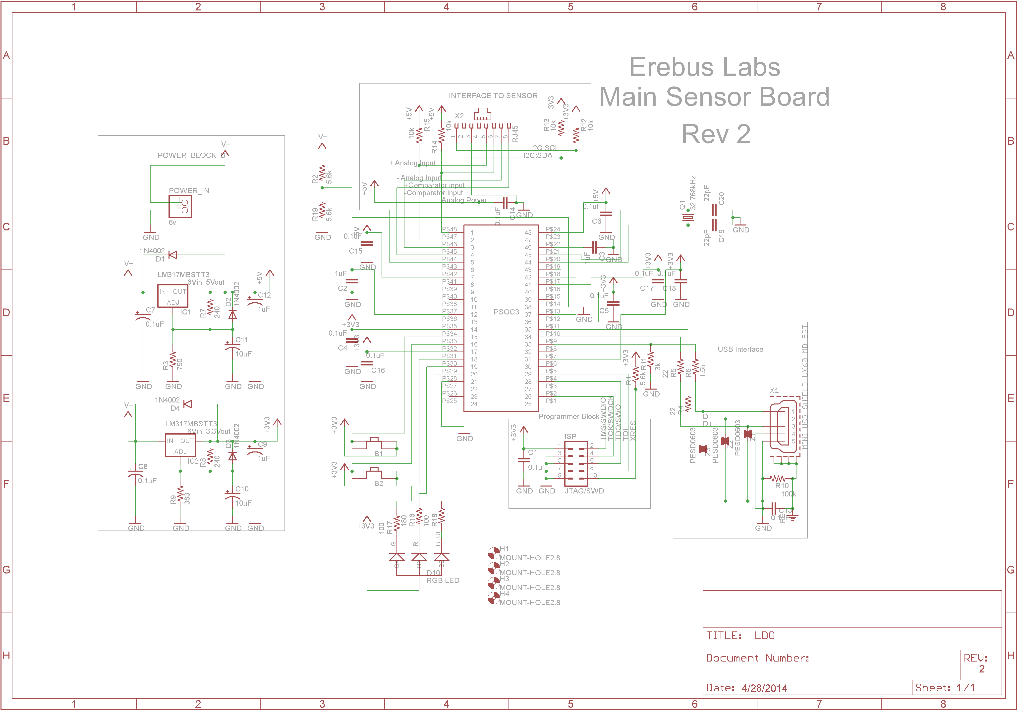

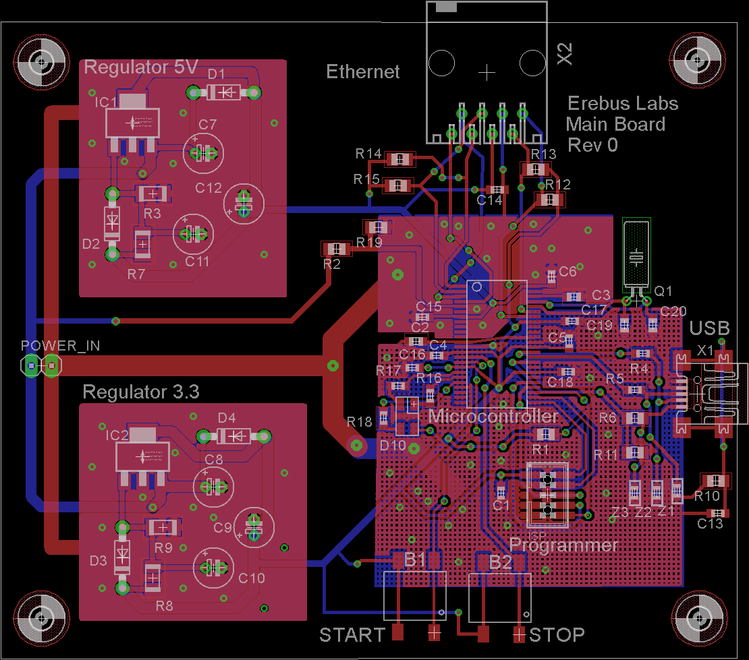

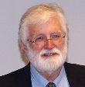

Erebus Labs STEM Sensor
Overview
Objective
Current educational curriculum in the US lacks a focus on Science, Technology, Engineering, and Mathematics (commonly referred to as STEM). Though more emphasis is starting to be placed on STEM education, a major hurdle for that education is simply getting kids interested in STEM topics. Negative interest begins in elementary classrooms where %33 of fourth grade students’ attitudes are already hostile towards science and math with that number increasing to %50 by 8th grade¹. Furthermore, according to the United States department of education, only %16 of American high school seniors are proficient in mathematics and interested in a STEM career².
Our goal was to create a device that would allow students, or anyone who is interested, to easily measure the world around them. Getting kids interested in the ideas behind science and engineering is the first step to getting them interested in a STEM career later. While there are already devices available (called DAQs) that allow the connection of environmental sensors for measurement taking, these typically require programming experience and other expertise to be usable. Instead, we wanted to make the process as seamless as plugging a sensor into a data collection device so students could focus on collecting data.
Surveys performed by the National Center for Education Statistics (NCES) in 2013 showed that 42% of 4th grade students performed at or above proficiency in mathematics which is fundamental to all STEM fields. By 8th grade that proficiency dropped to 36%. It is both this decrease in proficiency the large decrease in interest in STEM which we want to address by making STEM subjects more interesting to younger student.
Implementation
For the processor, we chose to use the Cypress PSoC 3 system on a chip. We chose this due to its low cost, feature set, and flexibility. The PSoC 3 architecture allows most pins to be used for any application (such as a GPIO or an ADC). It also has built in SRAM and EEPROM which helped us avoid the need for additional chips.
50% of 8th graders have a hostile attitude towards math & science
The Team
The PSoC Creator software which is used to program the PSoC 3 hosts APIs and block diagram based programming. While quite a bit of code still needed to be written by hand, the well documented APIs included in the software facilitated the rapid design of our prototype.
Scott Lawson
Computer Engineering
Maxwell Cope
Electrical Engineering
Bryan Button
Electrical Engineering
Chris Clary
Electrical Engineering
An additional bonus of the PSoC Creator software is that it is free to download with no limits. This way schools or individuals who wish to continue working on this do not need to pay for development software.
References
Mike Borowczak, Ph.D. - Sponsor
Data Analytics Engineer @ SolidFire
Founder @ ErebusLabs
www.becpdx.org/nem/stemconnect.aspx
www.ed.gov/stem
http://nationsreportcard.gov/reading_math_2013
Andrea Burrows - Sponsor
Assistant Professor of Secondary Education
University of Wyoming
James E. Morris - Advisor
Professor of Electrical and Computer Engineering
Portland State University
Department of Electrical and Computer Engineering

